Slide 1

UXJourney
the
The process to optimize your resource for the quality User Requirement
ISMAIL WAHYU FADILAH
202010370311339
CLASS 7D
W R I T T E N B Y H C I G R O U P

Slide 2
UXJourney
the
The process to optimize your resource for the Requirement quality User
Second Versions
Written by HCI Group
Universitas Muhammadiyah Malang and Universiti putra malaysia
Wahyu Andhyka Kusuma Azrul Hazri bin Jantan Novia Admodisastro Noris Mohd Norowi

Slide 3
UXJourney
the
The process to optimize your resource for the quality User Requirement
The UX journey is a process that helps optimize resources for quality user requirements while improving self-efficacy. The process involves a series of steps that begin with understanding the user's needs and expectations. This includes research to gain insights into the user's goals, motivations, and pain points. Once the user's needs have been identified, the next step is to develop a user persona, which is a detailed description of the user's characteristics, preferences, and behaviors. This persona serves as a reference point throughout the UX design process.
The next step in the UX journey is to define the user journey, which is the user's path to achieving their goals. This includes mapping out the steps involved in the user's interactions with the product or service and identifying potential pain points or areas for improvement.
Once the user journey has been defined, the UX designer can prototype and test different solutions. This involves creating wireframes, mockups, and prototypes of the product or service and testing these designs with users to gather feedback and identify areas for improvement.
Throughout the UX journey, it is important to focus on the user’s needs and expectations and continuously iterate and improve the design based on feedback and testing. By following this process, designers can optimize their resources to deliver quality user requirements while building their self-efficacy and confidence in their design decisions.

Slide 4
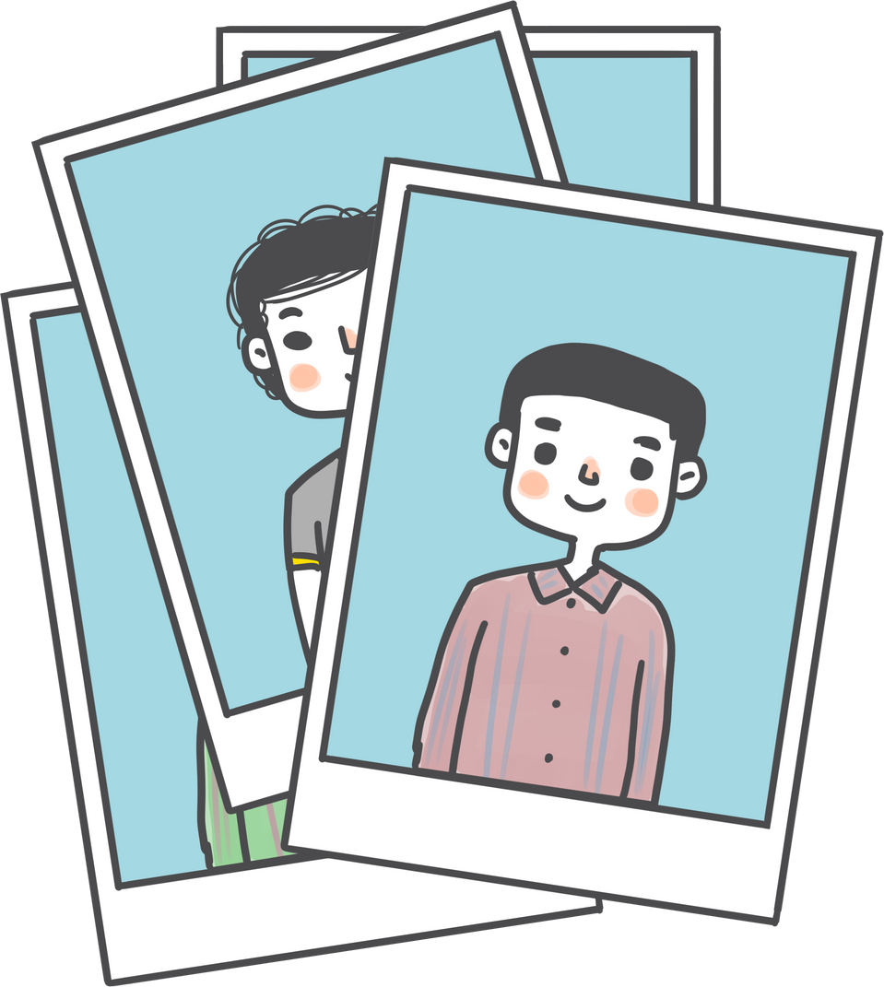
Hello
This is my UX Diary
PLACE YOUR
PHOTO
HERE
Tell me about your personality and ability
Hello, I am Ismail Wahyu Fadilah, or commonly called Fadilah. I am a student of Bachelor of Literature 1 Informatics Engineering Program at the University of Muhammadiyah Malang with NIM 202010370311339. I have a great interest in model design techniques, particularly in the context of user experience (UX). I believe that UX plays an important role in producing a more functional, efficient, and satisfying product or system for the end user. I am constantly striving to deepen my knowledge and skills in the UX journey through on-campus learning and also through activities outside the classroom. I am excited to continue contributing to the development of products or systems that can improve the quality of user experience.

Slide 5
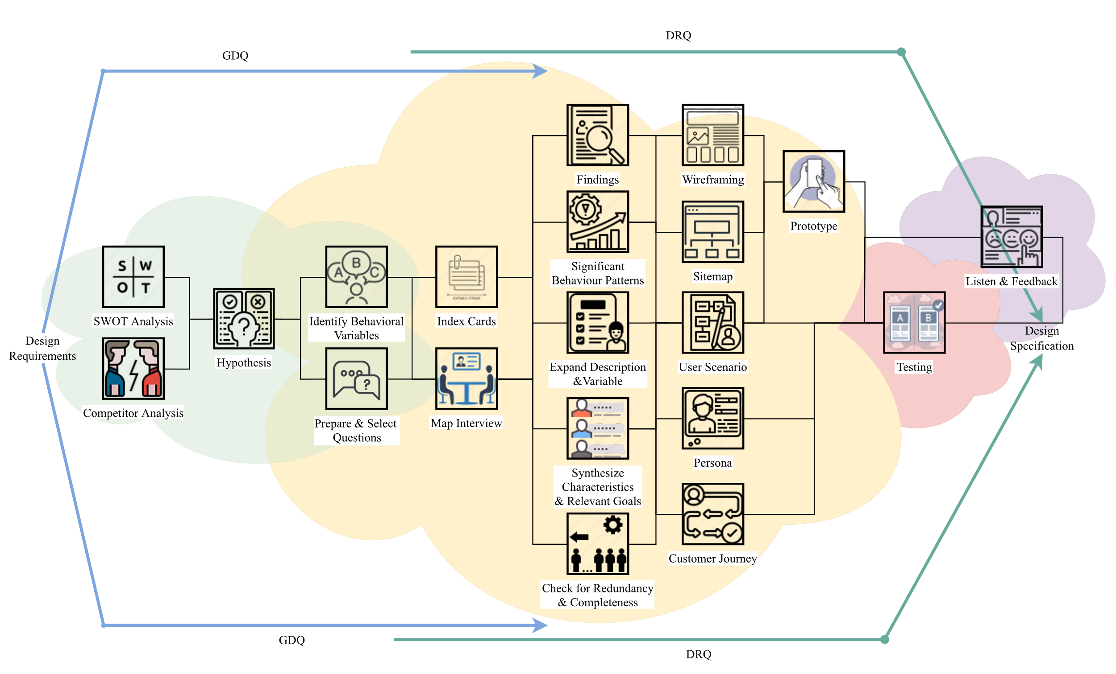
UXJourney
the
The process to optimize your resource for the quality User Requirement

Slide 6
UX Journey Activities Checklist
Activity | Time* | Activity | Time*
(D) Discover |  | Expand the Description of Attributes and Behavior | 4
Field studies | 20 | Persona | 16
SWOT Analysis | 60 | Journey Mapping | 50
Competitor Analysis | 6 | User Scenario and Stories | 13
State hypotheses | 14 | Sitemap | 2
Identify Behavioral Variables | 2 | Wireframing | 16
(E) Explore |  | (T) Test
Prepare Questions | 8 | Quantitative & Qualitative Usability Testing | 12
Meet Stakeholder | 8 | A/B Testing | 30
Index Card | 16 | Objective Verification | 4
Map Interview Subjects to Behavioral Variables | 16 | Variable Verification | 4
Identify Significant Behavior Patterns | 4 | Acceptance Criteria | 45
Synthesize Characteristics and Relevant Goals | 8 | (L) Listen
Check for Redundancy and Completeness | 8 | Follow up | 10
*Time in minutes

Slide 7
My Goals
10
Kickstart Project | Day 1 Mempelajari materi yang akan dikerjakan pada proyek B dan mempersiapkan bahan yang akan dimasukkan kedalam dokumen | Day 2 Menyelesaikan dan mendikumentasikan personality and ability, UX jurney activities checklist, dan My Goals | Day 3 Menyelesaikan dan mendokumentasikan Field STudies, SWOT, dan COmpetitor
Time allocation
Day 4 Menyelesaikan dan mendokumentasikan Hypothesis, Identify Behavioral Variable dan Prepared Questions | Day 5 Menyelesaikan mendokumentasikan meet stakeholders dan findings | Day 6 Menyelesaikan dan mendokumentasikan Index Card dan Map Interview | Day 7 Menyelesaikan dan mendokumentasikan Significant behavior pattern
Day 8 Menyelesaikan dan mendokumentasikan Synthesize characteristics dan check for redundancy | Day 9 Menyelesaikan dan mendokumentasikan validation, verification dan expand description | Day 10 Menyelesaikan dan mendokumentasikan persona, custom journey, dan user scenarios | Day 11 Menyelesaikan dan mendokumentasikan site map, wire framing dan qualitative
Day 12 Menyelesaikan dan mendokumentasikan A/B Testing, Verification dan objective behavioural variable | Day 13 Menyelesaikan dan mendokumentasikan acceptance criteria dan follow up | Day 14 Mensubmit Proyek | Deliver Project

Slide 8



Slide 9
Field studies
20
In today's information systems in various parts of the world are very fast developing in all aspects of life. The impact of technology is growing rapidly globally. Everything can be accessed with technology such as one example is in the field of aviation. Flights are currently experiencing rapid progress, especially in booking airline tickets. The use of information systems makes it easier for prospective passengers to get information about flights. E-Ticketing is an opportunity to minimize the use of costs and optimize quality in achieving passenger comfort. E-ticketing increases the flexibility of passengers and travel agents in flight schedules. This e-ticketing can be easily purchased by cash. Cheque or Credit/ ATM. E-ticketing can also reduce the risk of missing tickets / losing tickets because they are virtually on the device.

Slide 10
SWOT analysis
60
Strength
Advantages? | The application is designed with a display that is easy to use by users.
Uniqueness? | This application has easy and complete transaction features in payment.
Selling Points? | Call center menu for users asking for problems
Skills? | Book flight tickets anywhere and anytime with sufficient internet network coverage
Other factors? | The update feature wort it, a lightweight application on the device.
Weaknesses
Limitations? | Tickets are limited in booking flight tickets with various destination destinations.
Lack of effort? | Security in Baggage for Airline Passenger Items
Problems? | Menu of placement and tracking of luggage of flight passengers who are still lacking
Poor strategy? | Usage and use of rarely used features
Other factors? | -
Opportunities
Improvements? | on-site booking immigration becomes the use of the E-Ticket application
Performance? | Fast and smooth use of the application
Opportunities? | Luggage tracking feature
Consumer behavior? | Addition of services by adjusting the needs of the wearer
Other factors? | -
Threats
External trouble? | Competition is so fierce in the progress that business competitors create
obstacles? | Human resources and costs in making this project
Trends? | Fast and Adjust Advances in information technology, otherwise it will be less competitive
Other factors? | -

Slide 11
Competitor
6
DIRECT COMPETITION
INDIRECT COMPETITION
Traveloka
Travel
USER REVIEWS
In the opinion of direct, namely in the Flight E-Ticket application, there are several shortcomings that still do not support easy registration by only inputting the citizenship master number

Slide 12
Hypotheses
10
HYPOTHESES PERSONAS
EXPLANATION
HPS 1
HPS 2
HPS 3
HPS 4
HPS 5
Lita
Teo
Burhan
nesa
jumianti
These users have difficulty in ticket cancellation, refund process, and airplane seat selection This user is not smooth in using his device and difficult to get flight information This user has difficulty in informing his luggage, and the compensation costs given when the item is lost This user has difficulty filling in personal data, because there are many documents that must be prepared This user has difficulty in the fees charged, so they want to be able to use paylatter

Slide 13
Hypotheses Explanation
6
The hypotheses here are obtained from my observations of several personas and the help of information from several research journals related to the flight e-ticket application system, many personas experience problems in ticket booking and cancellation problems. Some information about departure is also lacking, and handling is quick in case of loss of luggage in the baggage.

Slide 14
Identify Behavioral Variables
2
OBSERVED BEHAVIORAL VARIABLE
SCALE
Difficulty obtaining flight information Difficult ticket cancellations and refunds Difficult to choose a seat booked within an airline Difficulty understanding online payments made Difficulties in using heavy applications and problems that occur
(Often – No) (Often – No) (Often – No) (Often – No) (Often – No)

Slide 15
Variable Explanation
6
1. Find the results of how many people have difficulty booking airline tickets by making difficult bookings 2. Find the results of the number of people who still have difficulty in using a substandard system 3. Find the results of the number of people who have difficulty in filling out personal data documents 4. Find the result of the number of people who have difficulty in ticket cancellations and refunds 5. Find the result of the number of people who have problems with their payments

Slide 16


Slide 17
1 5-minute prepare questions
8
2 Minutes | Welcome Remarks | 1.Asslamu'alaikum, Introduce my name Ismail Wahyu Fadilah, I am a student of UMM Informatics Engineering would like to conduct an interview with you to seek opinions for the application system for ordering masonry services
2 Minutes | Collect demographics | 2. Allow you to introduce yourself first
2 Minutes | Tell a story | 3. As an application developer, I need to ensure that the application is easy to use, as well as provide input from about the shortcomings of the application developed so that the application can be as expected.
2 Minutes | Problem ranking | 4. The following are related to the problems that exist as a user, in your opinion; As a passenger who uses, how is the experience when using this booking application that has been felt for a long time using teller services, as well as innovations that make progress in this application
3 Minutes | Explore customer's word view | 5. Related to the use of the application, are there things that make it difficult for users to the application or are there things that might be added to become additional features in the application
2 Minutes | Wrapping up | 6. Maybe that's all for the interview session I did this time, thank you for wanting to be a resource person for the process of making my application system
2 Minutes | Document results | 7. This interview document is used for consideration before making a better application.

Slide 18
Prepared questions
8
As a person who still doesn't understand the application, do you How to book tickets correctly? As a customer, how do you get to book tickets well in advance? Busy with busy daily activities? Help solve all the problems you mentioned? If so, what features do you want to need in the e-ticket application?

Slide 19
Creativity is intelligence having fun
Albert Einstein

Slide 20
Meet stakeholder
8
OBJECTIVE AND EXPECTED RESULTS
The objectives are generated and created to facilitate passengers in traveling without constraints in ticket booking, flexible in determining schedules, destination destinations, ticket costs and the level of travel comfort facilities, with flexibility of changes and cancellations.
5 MINUTES QUESTIONS
Does this flight booking system run smoothly and is it comfortable to use? Is this flight booking easy to book? Does registering and filling in your flight booking personal data feel easier? If not, what way makes it easier for you to fill in your personal data? Is using filght booking already difficult in making flight schedule changes and cancellations? What do users expect in booking tickets on this flight booking?

Slide 21
Findings
8
MENTION YOUR FINDINGS
From the opinions of stakeholders in using flight booking, it is quite easy to make reservations, it is also flexible. Such as easy ticket booking, can immediately determine when to depart, can determine the destination of the destination, as well as complete information in ticket costs and the latest information about recommended visit destinations.
MENTION YOUR FINDINGS
This flight booking application is smooth and easy to use, where the storage needed by this application has been compressed and as fast as possible in using this application on devices that are less crowded though
MENTION YOUR FINDINGS
In registering for flight booking, it has been facilitated by the database that has been prepared. Users only need to enter the NIK so that the user data has been combined with the state data data.

Slide 22


Persona name: Lita
16
As a user, I need Application system there is a CS feature.
As a user, I Requires a system Appsthat can display tickets in the application.
As a user, I need Application system can cancel ticket booking.
Share your idea, write in this notes

Slide 23
Persona name:
16
application that doesn't Incriminating
Ticket booking not complicated for time changes and cancellation
want the features that Get information Complete in Destination
Share your idea, write in this notes

Slide 24
Persona name:
Burhan
16
want to make it easy in returns funds when i m cancel ticket
Data validation Easy in Departure
in payment Easy booking Tickets
Share your idea, write in this notes

Slide 25
Persona name:
16
As a user, I need Application system can not be too Lots of menus.
As a user, I need Application system can see How many passengers already booking.
As a user, I need Application system can display How To Tutorial Use.
Share your idea, write in this notes

Slide 26
If a User is having a problem, it's our problem.
Steve Jobs

Slide 27
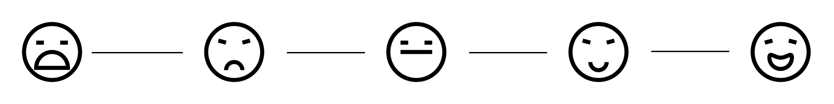
Map Interview
16
USER FEELING
Persona:
Variable: 1. 1 Does this flight booking system run smoothly and is it comfortable to use?
Scale 1: Not Happy | Scale 2: | Scale 3: Just Normal | Scale 4: | Scale 5: Happy
Respondent: 1. 2. | Respondent: 1. 2. | Respondent: 1. 2. | Respondent: 1. 2. | Respondent: 1. 2.
Variable: 2. Is this flight booking easy to book?
Scale 1: Not Satisfied | Scale 2: | Scale 3: Just normal | Scale 4: | Scale 5: satisfied
Respondent: 1. 2. | Respondent: 1. 2. | Respondent: 1. 2. | Respondent: 1. 2. | Respondent: 1. 2.

Slide 28
Map Interview
16
USER FEELING
Persona:
Variable: 3. Does it make it easier for you to fill in your personal data?
Scale 1: Dificult | Scale 2: | Scale 3: Just normal | Scale 4: | Scale 5: Easy
Respondent: 1. 2. | Respondent: 1. 2. | Respondent: 1. 2. | Respondent: 1. 2. | Respondent: 1. 2.
Variable: 4. Is using filght booking already difficult in making flight schedule changes and cancellations?
Scale 1: Dificult | Scale 2: | Scale 3: Just normal | Scale 4: | Scale 5: Easy
Respondent: 1. 2. | Respondent: 1. 2. | Respondent: 1. 2. | Respondent: 1. 2. | Respondent: 1. 2.
Variable: 5. Is it easy to choose a seat on the plane
Scale 1: Not Satisfied | Scale 2: | Scale 3: Just normal | Scale 4: | Scale 5: satisfied
Respondent: 1. 2. | Respondent: 1. 2. | Respondent: 1. 2. | Respondent: 1. 2. | Respondent: 1. 2.

Slide 29
Significant Behaviour Patterns
2
OBSERVED BEHAVIORAL VARIABLE
SCALE
PERCENTAGE
Difficulty obtaining flight information The difficulty of booking flight tickets Difficulty in filling out personal data documents The difficulty in accessing the applicationI Problems in ticket cancellation
Agree Neutral No Agree Neutral No Agree Neutral No Agree Neutral No Agree Neutral No
50% 40%10%
20% 60%20%
30% 50%20%
10% 20%70%
40% 20%40%

Slide 30
Pattern Explanation
6
Running the percentage results from the interview results to personas: 1. First variable: 50% answer affirmative, 40% answer Neutral, 10% no 2. First variable: 20% answered in the affirmative, 60% answered Neutral, 20% no 3. First variable: 30% answered in the affirmative, 50% answered Neutral, 20% did not 4. First variable: 10% answer affirmative, 20% answer Neutral, 70% no 5. First variable: 40% answered in the affirmative, 20% answered Neutral, 40% did not

Slide 31





Synthesize Characteristics And Relevant Goals
8
PATTERN
Persona:
Variable: 1
 | 10% | ___% | 40% | ___% | 50%
Variable: 2
 | 20% | ___% | 60% | ___% | 20%
Variable: 3
 | 20% | ___% | 50% | ___% | 30%
Variable: 4
 | 10% | ___% | 20% | ___% | 70%
Variable: 5
 | 40% | ___% | 20% | ___% | 40%

Slide 32
Synthesize Explanation
14
Based on SYNTHESIZE, CHARACTERISTIC, AND RELEVANT GOAL data, patterns are obtained. The explanation is as follows: Variable 1: Applications that do not burden users in their devices There is a persona 1 who feels frequent difficulties Persona 2 feels neutral on the issue of difficulty Persona 2 doesn't feel any trouble Variable 2 application is smooth in day determination and information price There is a persona 1 who feels frequent difficulties Persona 3 feels neutral on the issue of difficulty Persona 1 doesn't feel any trouble Variable 3 makes it easy to fill in personal data There is a persona 1 who feels frequent difficulties Persona 2 feels neutral on the issue of difficulty Persona 2 doesn't feel any trouble Variable 4 Is using filght booking no longer difficult in making flight schedule changes and cancellations? There are Persona 3 who feel frequent difficulties Persona 1 feels neutral on the issue of difficulty Persona 1 doesn't feel any trouble Variable 5: Is it easy to choose a seat? On board There are Persona 2 who feel frequent difficulties Persona 1 feels neutral on the issue of difficulty Persona 2 doesn't feel any trouble

Slide 33
Want your
users to fall in
love with your
designs? Fall in
love with your users.
Dana Chisnell

Slide 34
Check for Redundancy and Completeness
2
Is there anything missing from the personas mappings, characteristics and objectives that needs to be added?
If so, please specify: No
To satisfy stakeholder assumptions or requests, does any other persona need to be added?
If so, please specify which persona should be added:
Are they any two personas that differ only as to social-demographic variables?
If so, please specify what decision is to be taken:
Remove one of the personas. If so, specify which one:
Examine characteristics more thoroughly and differentiate personas.:
Are all created personas significantly different?
If so, please state which personas are alike:
Overall, are the created personas representative enough of the diversity of real-world behavior and needs?
Yes, because the existing persona has been used to meet the research to explore the respondent

Slide 35
Expand Description and Variable
4
TODAY I AM FEELING...
same day every day, keep going
TODAY I AM GOTING TO...
more efficient and diligent
TODAY I AM LOOKING FORWARD TO...
start everything as usual
MY AFFIRMATION TODAY
Pursue the future as if you still have 1000 years to live and worship as if you have only 1 day left to live

Slide 36
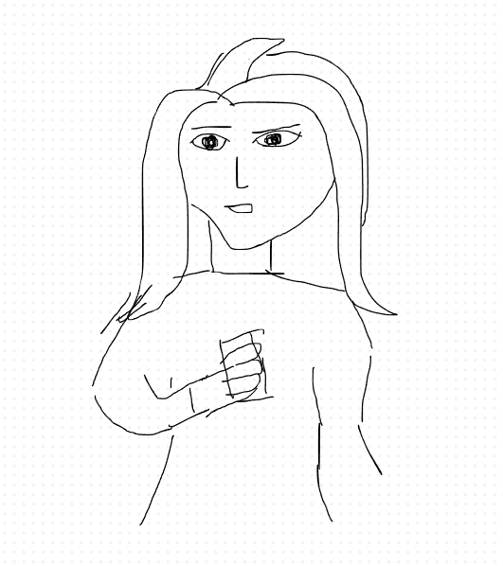
Persona
16
Persona name: Lita
Roles & tasks:Application Users
Age: 21
Profession: Worker
User quote:
Terus berambisi menjadi yang teratas
Personality traits/ behaviour: Sosial Media, Vlogger Content, Beauty
Lifestyle:
Motivation: Keep learning
Skill & Knowledge:
Novice (browsing, email)
Intermediate (social media)
Proficient (manage website)
Expert (programing complex web)
Authority (publish influential research)
Other Skill & Knowledge:
Segment:
Difficulty in boarding flight tickets
Sketch persona:

Slide 37
To create a memorable design, you need to start with a thought that’s worth
remembering.
Thomas Manss

Slide 38




Customer Journey Mapping
50
1
Decide on a target customer persona and the scope of the journey to be explored today.
Give them a visual representation, name and description.
2
Use sticky notes to build a back story, including the customer's reasons for taking this particular journey.
3
Ideally, 1 persona = 1 journey map. Duplicate these pages to repeat the exercise for another persona.
Key Attribute
Short Description
Add your thought here
Lita
use the E-Ticket application Having problems with airlines
Add your thought here
Persona 1 [Insert persona's name here]
Needs
Challenges
requires an application that can be for Get flight schedule information
Requires device and internet network
Add your thought here
Add your thought here
Opportunities
Add your thought here
We can add and complete flight schedule information in real time in the update application

Slide 39




50
Persona 1
4
Describe the persona's journey in the first 3 rows, using one sticky note per action. "User actions" pertain to activities; "touchpoints" are interaction points like a website or email; and "pain points" refer to frustrations, errors and bottlenecks.
5
In the "emotions" row, move the dots up or down the colored spectrum to visually show how the persona's emotional experience rises and falls throughout the journey. Positive peaks = delight, while sudden drops = frustration.
6
In the final row, brainstorm possible solutions or areas of opportunity to improve the persona's experience.
Awareness
Consideration
Purchase
Onboarding
Advocacy
User Actions
Check the Schedule Flights and routes online
System Realtime
Interesting menu
Add your thought here
Add your thought here
Add your thought here
Add your thought here
Add your thought here
Simple Display
Touchpoints
Click the Ticket menu Airplane
Search system View schedules Complete flight
Pain points
D e l i g h t e d
Emotions
F r u s t r a t e d
Possible Solutions

Slide 40
Usability rules the Web. If customers can't find a product, they will not buy it.
Jakob Nielsen

Slide 41
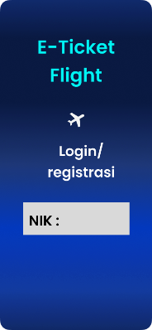
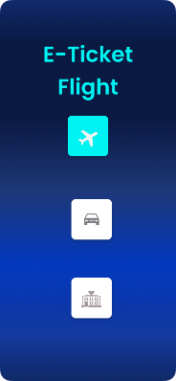
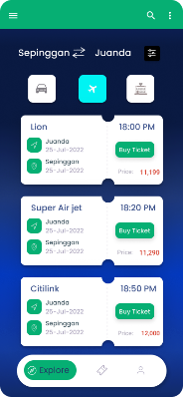
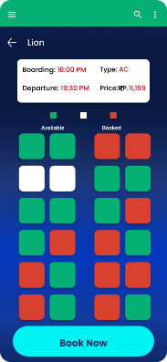
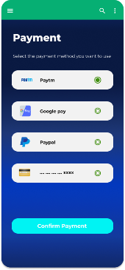

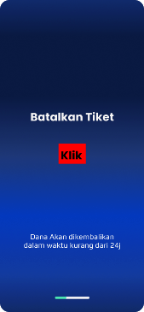
User Scenario and Stories
13
Users can register with NIK
Users can choose 3 menu order types
Users can choose Schedule, types, and prices
Users can choose Available seats
Users can Select Payment methods
User has succeeded Book tickets after payment
Users can cancel ticket after performing Flight booking

Slide 42
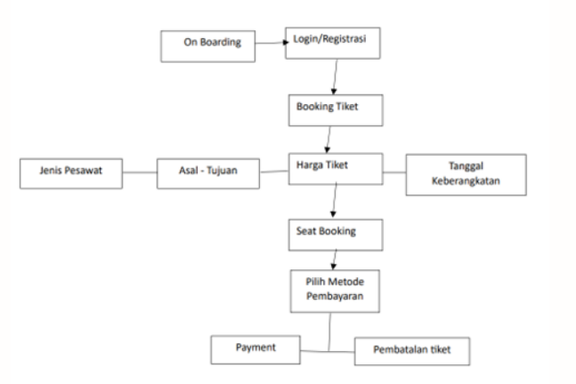
Sitemap
2

Slide 43
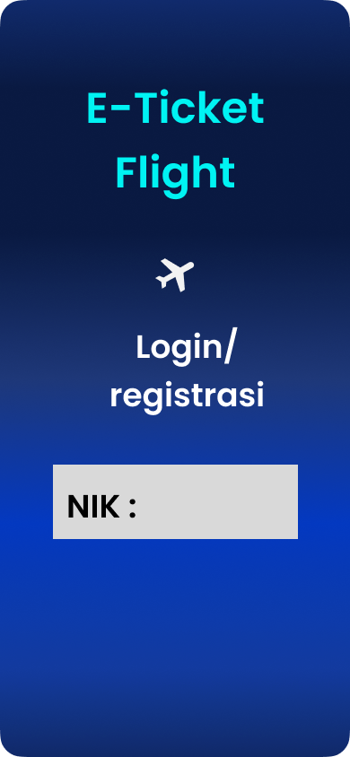
Wireframing
16
Screen name:
Menu Login/ Registrasi
Component:
NIK:
Heuristic violated:
Login menu display

Slide 44
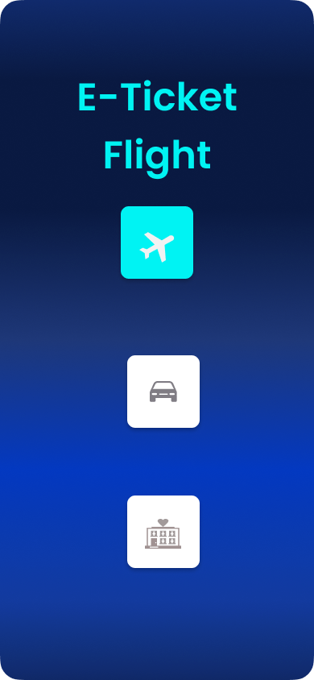
Wireframing
16
Screen name:
Main Menu
Component:
Button Plane Car Airport Hotel Airport
Heuristic violated:
Display various menus

Slide 45
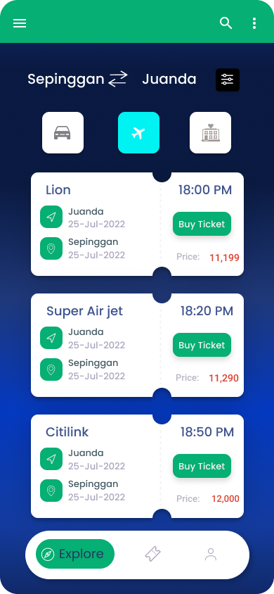
Wireframing
16
Screen name:
Booking Features
Component:
Button Purpose and beginning Schedule Price Buy tickets
Heuristic violated:
Display of Booking Features

Slide 46
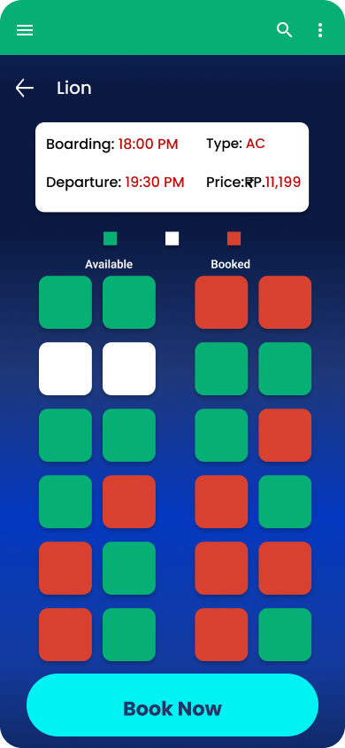
Wireframing
16
Screen name:
Fitur Seat Booking
Component:
Button Select Seat Green Book Now
Heuristic violated:
The display of this menu can see Aircraft seat availability

Slide 47
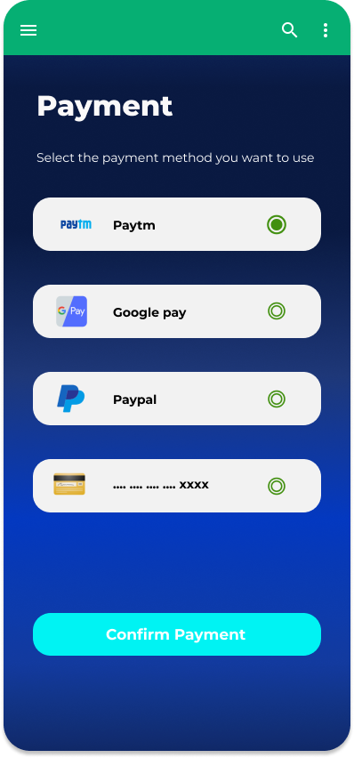
Wireframing
16
Screen name:
Payment Methods
Component:
Button Payment Methods multiple Methods* Paytm Google Play Pay Pal Debit Confirm Payment
Heuristic violated:
This view shows the features Payment methods

Slide 48


Slide 49

Qual & Quant
12
QUALITATIVE RESEARCH
QUANTITATIVE RESEARCH
Focus on "why"
Focus on "how many" & "how much"
Inform design decisions
Evaluate the usability of an existing site
Identify usability issuesand find solutions
Track usability over time
Findings based on the researcher’s impressions, interpretations, and prior knowledge
Compare site with competitors
USER REVIEWS
The reason I use quantitative research is because this research can focus deeply on the experience and feature features for users. One of them uses the AB Testing method, which is a method that is suitable for checking learning game systems whose function is to understand experience, identify needs, and as a comparison tool against similar systems with the latest systems based on what is needed by users.

Slide 50
AB Testing
30
Variable: 1
 | ___% | ___% | ___% | ___% | 80%
Variable: 2
 | __% | ___% | 20% | ___% | 80%
Note:
Note:
In this feature, users feel happy because easy login only uses NIK
In this display, users are less satisfied because many menus are not too important

Slide 51
AB Testing
30
Variable: 1
 | ___% | ___% | 20% | ___% | 80%
Variable: 2
 | ___% | ___% | 20% | ___% | 80%
Note:
Note:
In this display, users feel happy because there is a lot of information on flight schedules and features that are easy to understand
In this feature, users are quite happy because the selection of aircraft seats is simple and easy

Slide 52
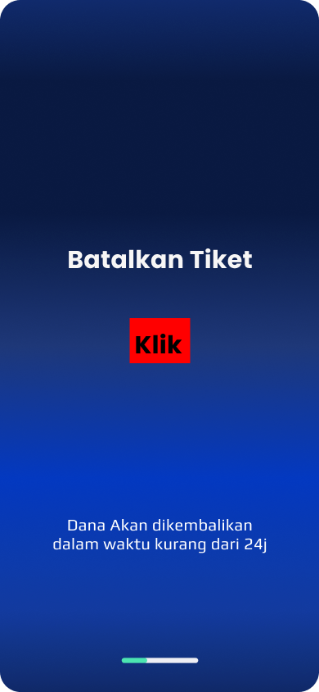
AB Testing
30
Variable: 1
 | __% | ___% | ___% | ___% | 100%
Note:
In this feature, users are quite happy because of the feature that immediately facilitates ticket schedule changes

Slide 53
Verification
4
PERSONAS
EXPLANATION
HYPOTHESES
H1
H2
H3
H4
H5
People who love to travel
From the results of the system test above, if tested Bandanding with similar applications, users already Experience this ticket booking application system already according to what the user expects and can function according to its usefulness.

Slide 54
Objective Explanation
4
The reason I am on the initial menu is made simply because it makes it easier for users to register because many users are also constrained in registering and filling in personal data, by making registration or logging in using NIK makes it easier to enter the application. And with the ticket cancellation feature which is often a problem in terms of changing flight ticket schedules due to several reasons by the user, this feature makes it easier for users to cancel their tickets.

Slide 55
Objective Behavioral Variables
4
OBSERVED BEHAVIORAL VARIABLE
SCALE
Ease of getting schedules and destination routes Easy flight price search Added customizable payment method feature Ease of cancelling bookings Ease of determining aircraft seats
1,2,3,4,5. 90% are already represented by user story people who love travelling

Slide 56
Acceptance Criteria
45
Positive Case
Given | When | Then | User Interface
Use Open the app | Open the App | The application displays the start menu for login registration with NIK

Slide 57
Acceptance Criteria
45
Positive Case
Given | When | Then | User Interface
User open application | Change the amount impellant | The application displays the type of aircraft selected available As long as Type : String Minimum : 4 characters Maximum : 25 characters A dropdown appears Required Purpose Type : String Minimum : 4 characters Maximum : 25 characters A dropdown appears Required Departure Type : Date Date pop-up appears Keembali Type : Date Date pop-up appears

Slide 58
Acceptance Criteria
45
Positive Case
Given | When | Then | User Interface
User goes to application | When the user is already Selecting the destination aircraft | The application displays several types payment Payment Type : Integer Minimum : 10 Maximum : 50 A dropdown appears

Slide 59
Acceptance Criteria
45
Positive Case
Given | When | Then | User Interface
The user is located on the page | Click cancel | Cancel a reserved ticket and the funds will be refunded within 24 hours

Slide 60


Slide 61
Follow up
10
The flight ticket booking system that we have developed is in accordance with what is needed by users such as flight schedule features, registration with NIK, flight ticket cancellation, real-time information. After further observation and analysis, users also still need to integrate this train booking system with the flight ticket booking system with passenger needs for ticket booking.

Slide 62

UXJourney
the
The process to optimize your resource for the quality User Requirement
From Developer for Developer

